Slide 1

Blockchain Based Academic Certificate Authentication System
K S SCHOOL OF ENGINEERING & MANAGEMENT, BENGALURU-560109
DEPARTMENT OF COMPUTER SCIENCE & ENGINEERING
PROJECT PHASE II
(17CSP78 )
Academic Year 2020-21 (Even)
Presented By
Project Guide
Mr. Sandeep H
Associate Professor,
CSE, KSSEM
1KG16CS012
1KG16CS033
1KG16CS096
1KG16CS118
Arun Kumar M Gnanendra Prasad T Shashidhara N Vummaneni Dilip

Slide 2
Outline
Introduction
Aim of the Project
Literature Survey
Objectives
Methodology
Technologies Used
Requirements
Design
Implementation
Result Analysis and Discussion
Conclusion
References

Slide 3
Introduction
India is a developing nation and is one of the emerging superpowers of the world.
Measures such as Industrialization and Digitalization has been effective in creating multiple job
opportunities.
However, hiring the right candidate has always been a tough job for employers.
They faced issues such as discrepancy in previous employments ,criminal convicts and fake educational credentials.
According to HIRERIGHT, about 56% of educational credentials provided for background check had inaccuracies. [6]

Slide 4
AIM OF THE PROJECT
To Provide secure , flexible Blockchain-based storage and Authentication system for Digital Records like Academic Certificates.

Slide 5
Literature Survey
An Overview of Blockchain Technology: Architecture, Consensus, and Future Trends[1]
Overview of blockchain technologies including blockchain architecture and key characteristics of blockchain.
Discuss the typical consensus algorithms used in blockchain, compared different available protocols.
Privacy Module for Distributed Electronic Health Records(EHRs) Using the Blockchain[2]
Proposes a blockchain framework for EHR management on a distributed network that could ensure ultimate privacy to patient’s health records.
Discusses configuration mechanism ensures which that all participating entities are authorized to exchange
and share this data

Slide 6
OBJECTIVES
To define a general schema and use cryptographic methods to create Digital Academic Certificates
To build a secure, scalable blockchain-based storage system for storage of the digital certificates
To develop an interface for data custodian and data consumer to store, manage and deploy data
certificates and upload, verify certificates respectively.

Slide 7
METHODOLOGY
Methodology of objective-1: A digital certificate is essentially a JSON Object with the necessary fields needed for our cert-issuer code to place it on the blockchain. For which a hash can be generated and used for verification purposes.
Methodology of objective-2: Blockchain storage methodologies like Bitcoin, Ethereum are utilized to develop an architecture to store and manage digital certificates.
Methodology of objective-3:Modern web development technologies such as React-js, Node-js are utilized to
build an interface which facilitates the user to view, manage and verify documents online.

Slide 8
Technologies used
Ethereum:
Ethereum is a global, open-source platform for decentralized applications. On Ethereum, you can write code that controls digital value, runs exactly as programmed, and is accessible anywhere in the world.
Ganache:
Ganache is a personal blockchain for Ethereum development you can use to deploy contracts, develop your applications, and run tests. Using Ganache we can deploy a local blockchain network in our system and use it for development purposes.
Node.js:
Node.js® is a JavaScript runtime built on Chrome's V8 JavaScript engine. As an asynchronous event- driven JavaScript runtime, Node.js is designed to build scalable network applications.

Slide 9
Truffle:
A development environment, testing framework and asset pipeline for blockchains using the Ethereum Virtual Machine (EVM).
With Truffle, we get:
Built-in smart contract compilation, linking, deployment and binary management.
Automated contract testing for rapid development.
Scriptable, extensible deployment & migrations framework.
Network management for deploying to any number of public & private networks.
Package management with EthPM & NPM, using the ERC190 standard.
Interactive console for direct contract communication.
Configurable build pipeline with support for tight integration.
External script runner that executes scripts within a Truffle environment.

Slide 10
Requirements
GPU: 2.30 Ghz
CPU: Intel i5-6200U / Intel Core or better
RAM: 3 GB or more
Operating system: Windows 7 , Windows 8.1 or later, Windows 10
Browser: Mozilla or Chrome (Latest version)
Ethereum Wallet: Required for Admin.

Slide 11
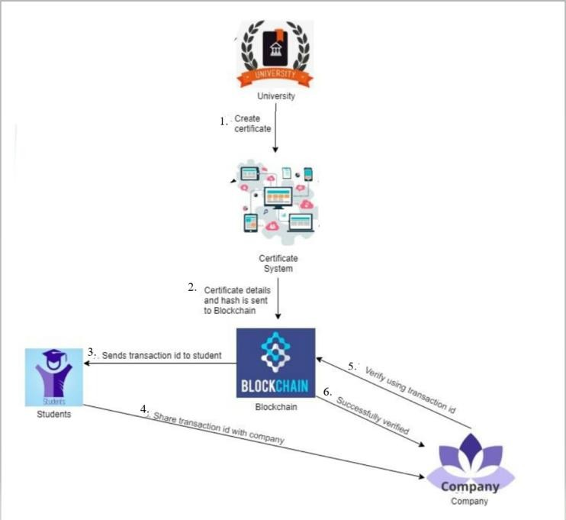
Brief Overview of Project
Fig 1. An overall model of How the certificate is stored in the blockchain network

Slide 12

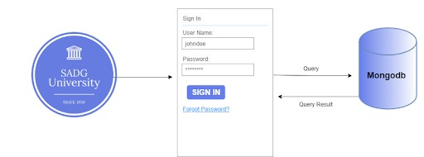
Design
Admin login
Fig 3. Interaction between Issuer and the Front end system.

Slide 13

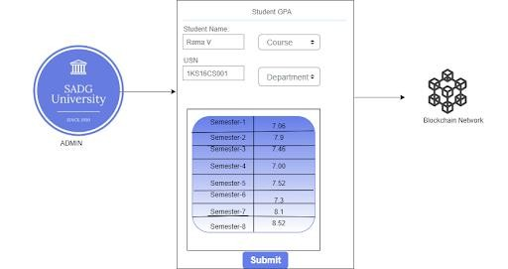
Filling Academic Certificate
Fig 4. Interaction between Issuer and the Blockchain Network.

Slide 14

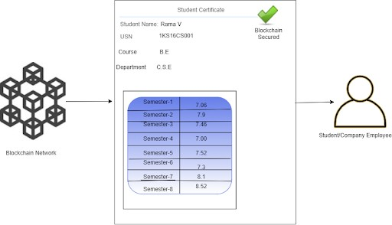
View and verification by Users
Fig 4. Interaction between User and the Blockchain Network.

Slide 15
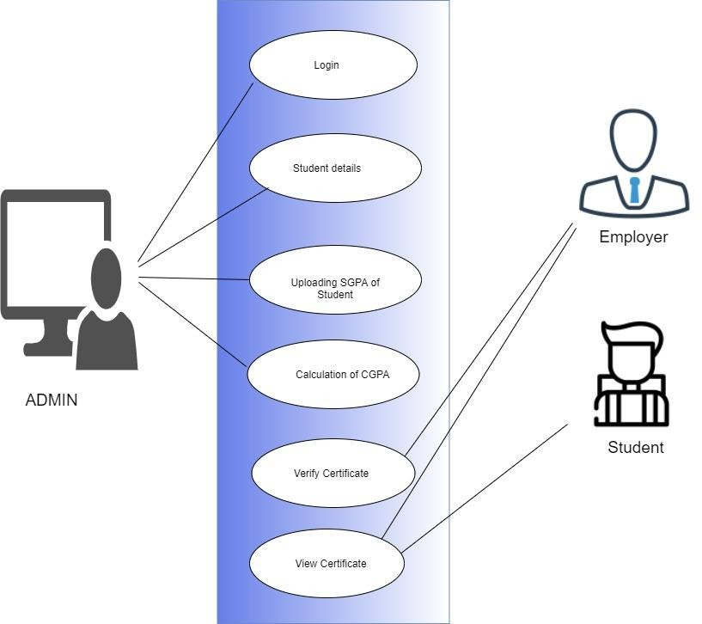
Use Case Diagram
Fig 2. Use Case Diagram For Blockchain based Academic Certificate Authentication System

Slide 16
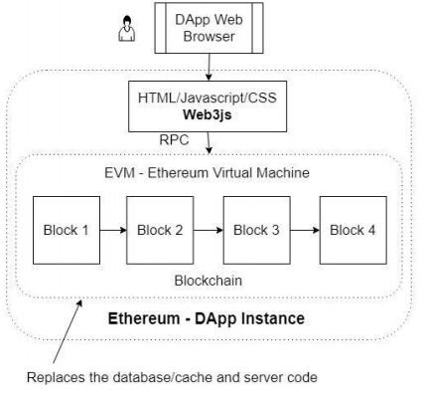
Ethereum Dapp Architecture
Fig 5. Ethereum Dapp Architecture

Slide 17
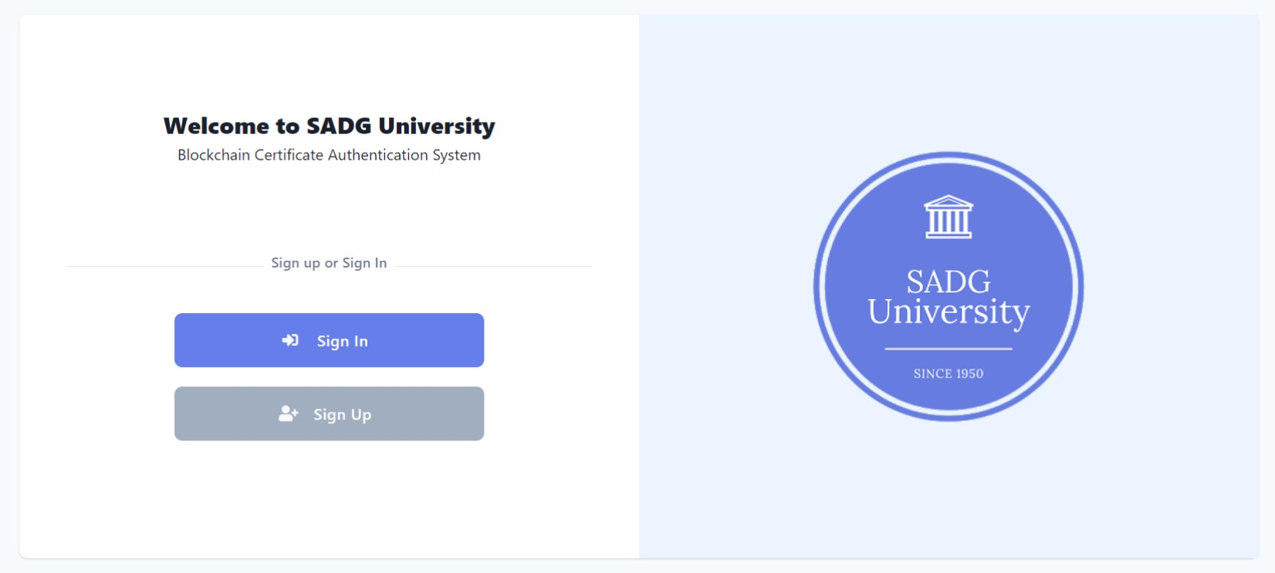
Implementation
Fig 6. Admin Login Page

Slide 18
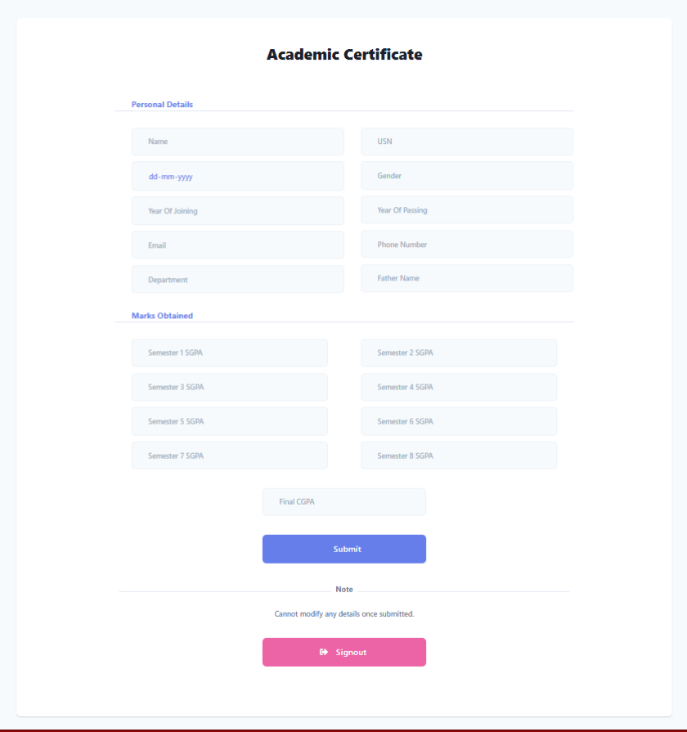

Implementation
Fig 7. Form to Fill Academic Details

Slide 19
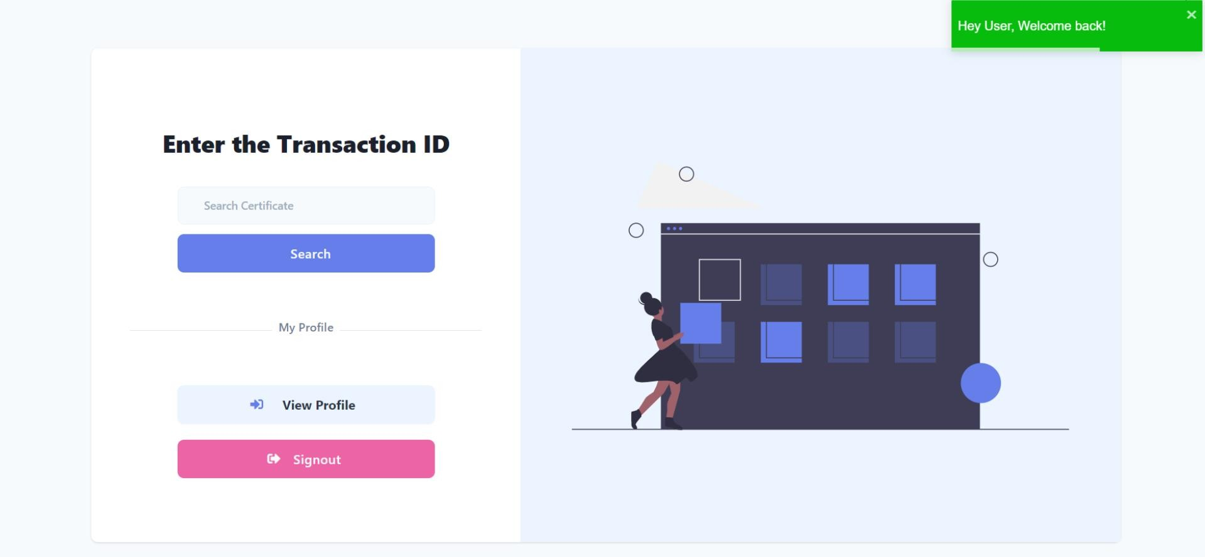
Implementation
Fig 7. Page to view Certificate

Slide 20
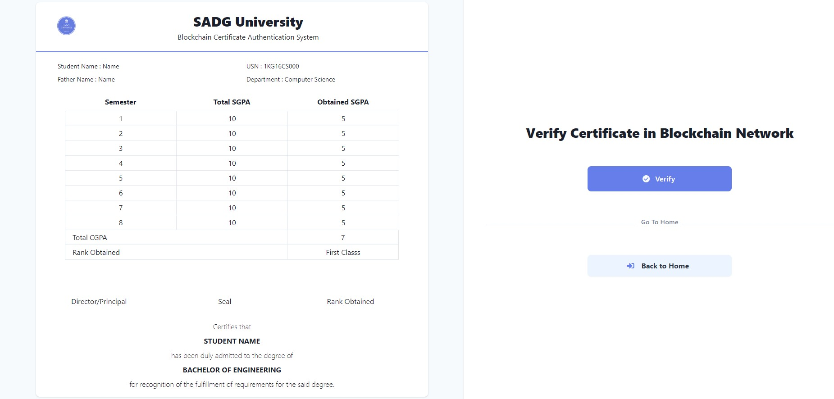
Implementation
Fig 8. Certficate View and Verify Page

Slide 21
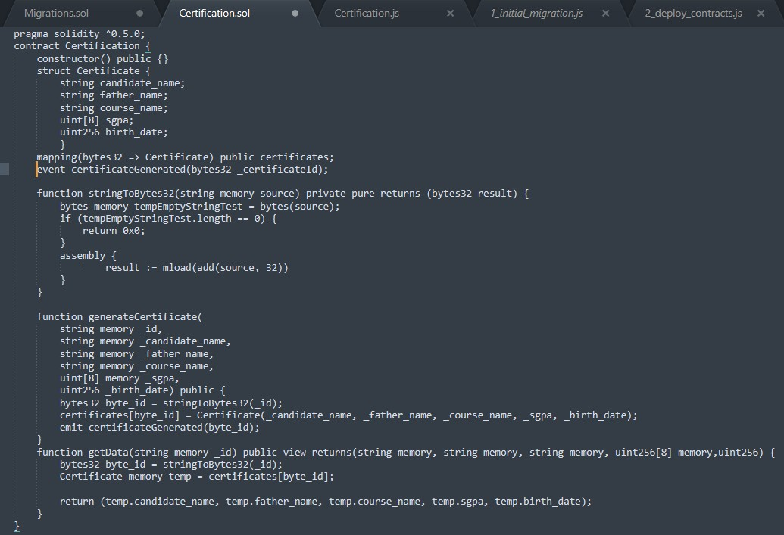
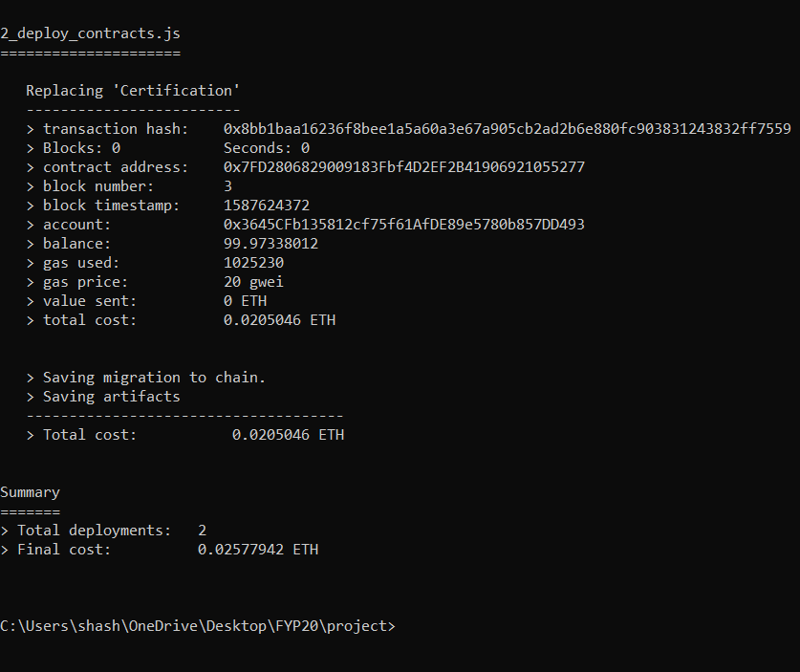
Implementation
Fig 9. Source code of Contract
Fig 10. Contract Deployment to Ethereum Blockchain

Slide 22
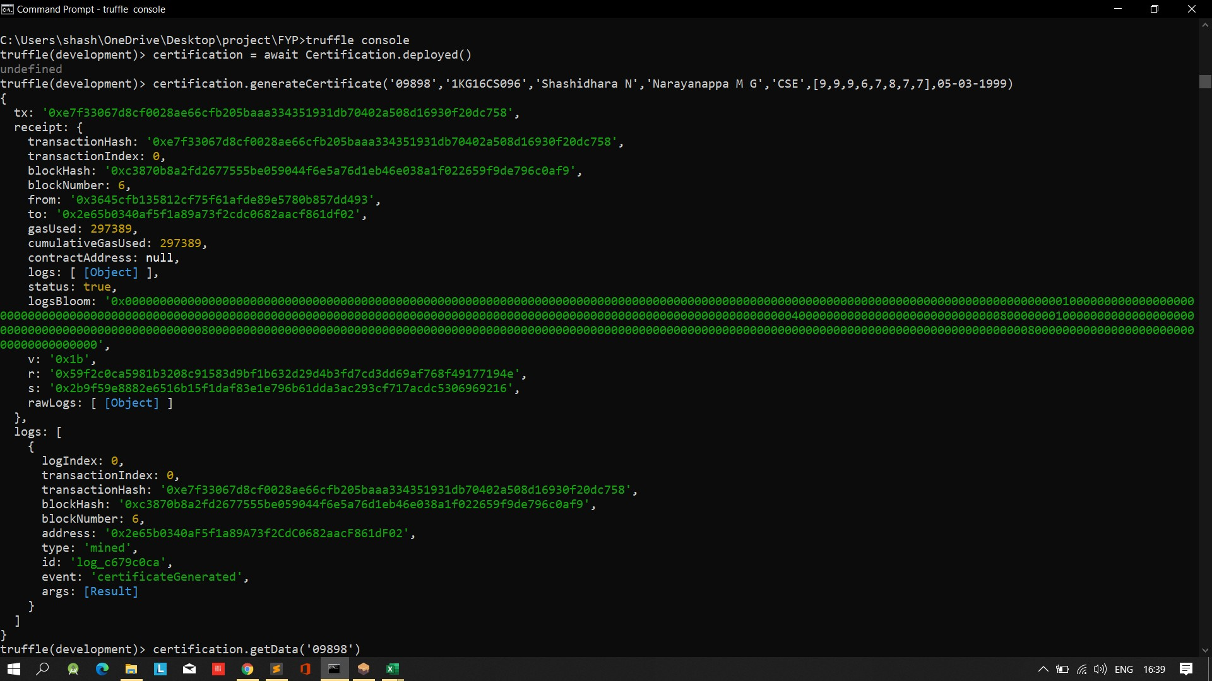
Implementation
Fig 11. Generating a Certificate

Slide 23
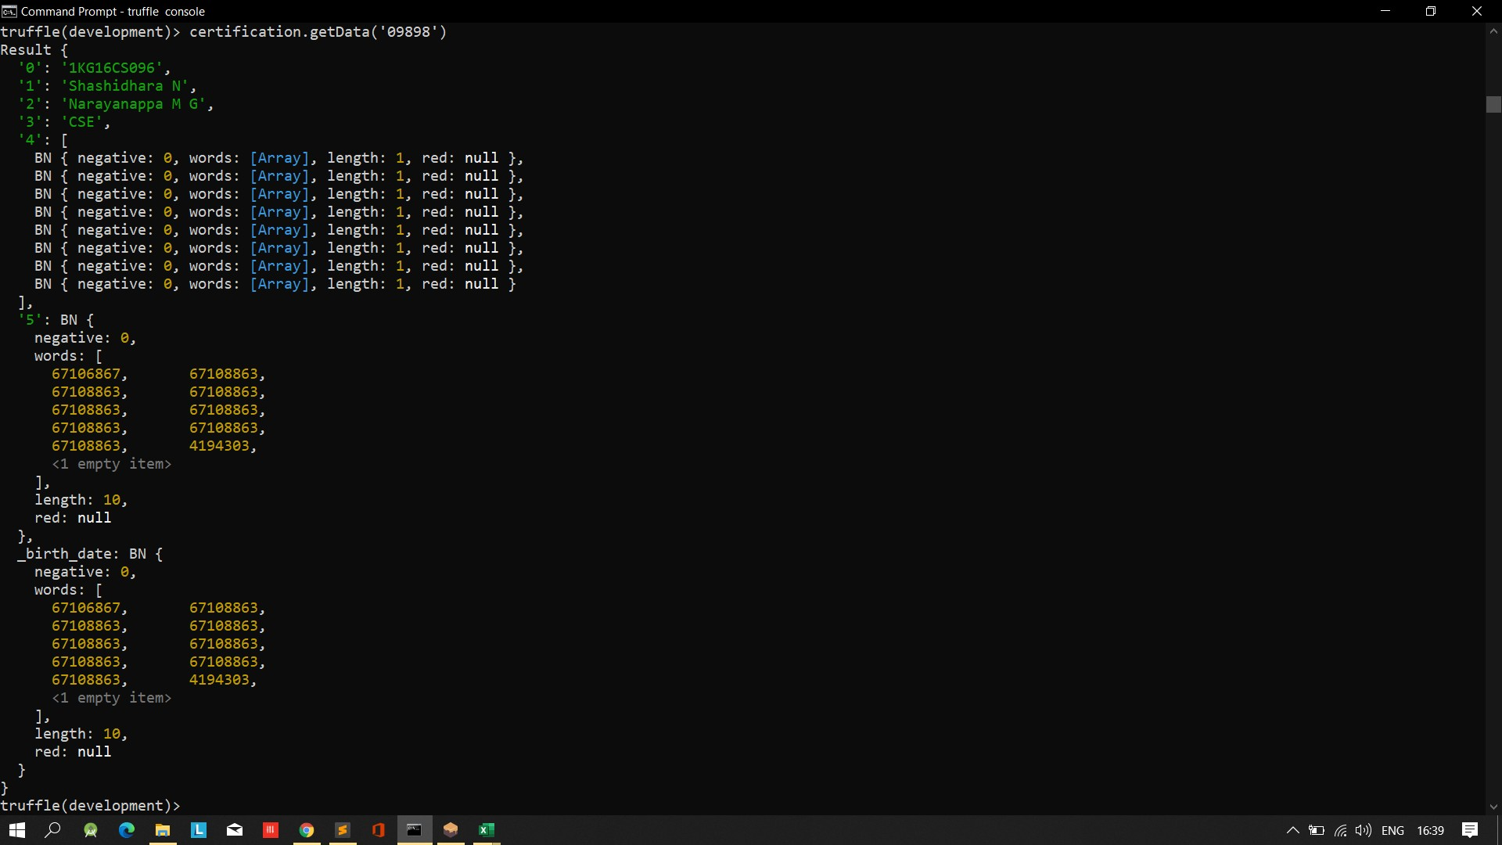
Implementation
Fig 12. Displaying a Certificate

Slide 24
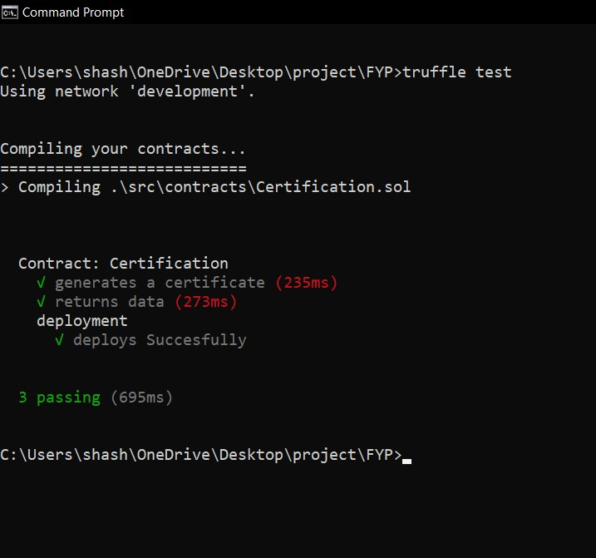
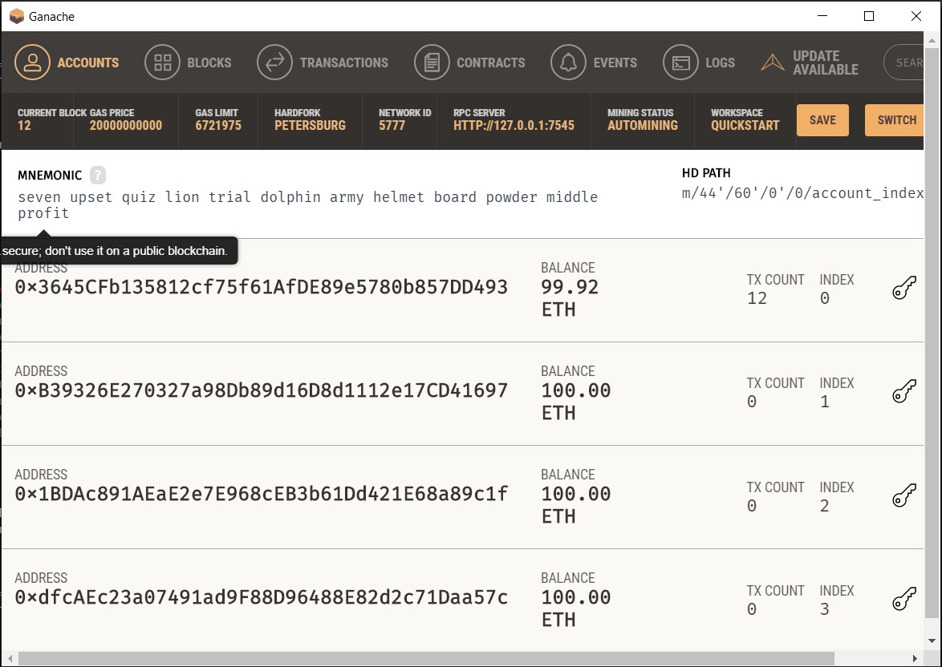
Implementation
Fig 13. Test Suite For Deployment
Fig 14. Ether being Used for Deployment

Slide 25
CONCLUSION
Objectives are being met within the expected time intervals.
All issues or cases are being extensively researched and discussed with guide, effective measures are
being taken.
Documentation is being done in parallel.
So far the work appears to be supporting the respective objectives.

Slide 26
REFERENCES
[1]. Zibin Zheng, Shaoan Xie, Hongning Dai, Xiangping Chen, and Huaimin Wang: An Overview of Blockchain
Technology: Architecture, Consensus, and Future Trends, 2017 IEEE 6th International Congress on Big Data
[2]. Richard Nuetey Nortey , Li Yue, Promise Ricardo Agdedanu , Michael Adjeisah : Privacy Module for Distributed Electronic Health Records(EHRs) Using the Blockchain , 2019 the 4th IEEE International Conference on Big Data Analytics
[3]. Mohammad Jabed Morshed Chowdhury, Alan Colman, Muhammad Ashad Kabir, Jun Han and Paul Sarda: Blockchain as a Notarization Service for Data Sharing with Personal Data Store, 12th IEEE International Conference On Big Data Science And Engineering
[4]. Blockcerts A project undertaken at Media Labs MIT , Available at https://www.blockcerts.org.

Slide 27
[5]. National Academic Depository (NAD) a project undertaken by MHRD, India Available: http://nad.gov.in/index.html
[6].https://www.moneycontrol.com/news/business/economy/indian-companies-face-difficulties-in-verifying- background-info-hireright-report-2578121.html
[7]. https://www.linkedin.com/pulse/why-blockchain-cryptocurrencies-creating-headlines-punit-kumar

Slide 28



THANK YOU

Slide 29





